Slide 1
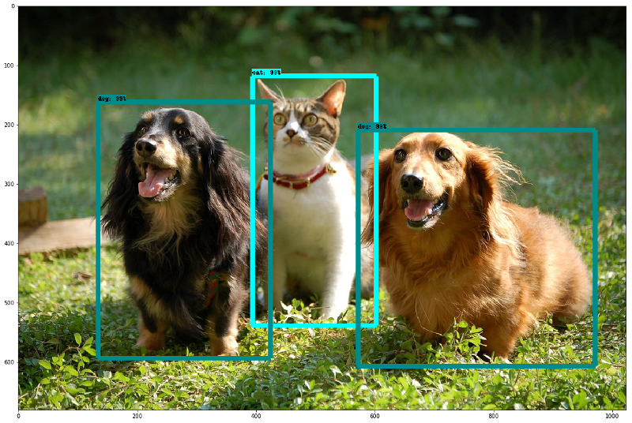
OBJECT - DETECTION USING SSD ARCHITECTURE (COMPUTER VISION PROJECT)
EOC 2 & MFC 2
GROUP 14
CSE(AI)-B
GROUP MEMBERS: ROLL NO:
VARSHITHA GADE CB.SC.U4AIE24114
MEERA NAMBIAR K C CB.SC.U4AIE24132
YASWANTH V CB.SC.U4AIE24160

Slide 2
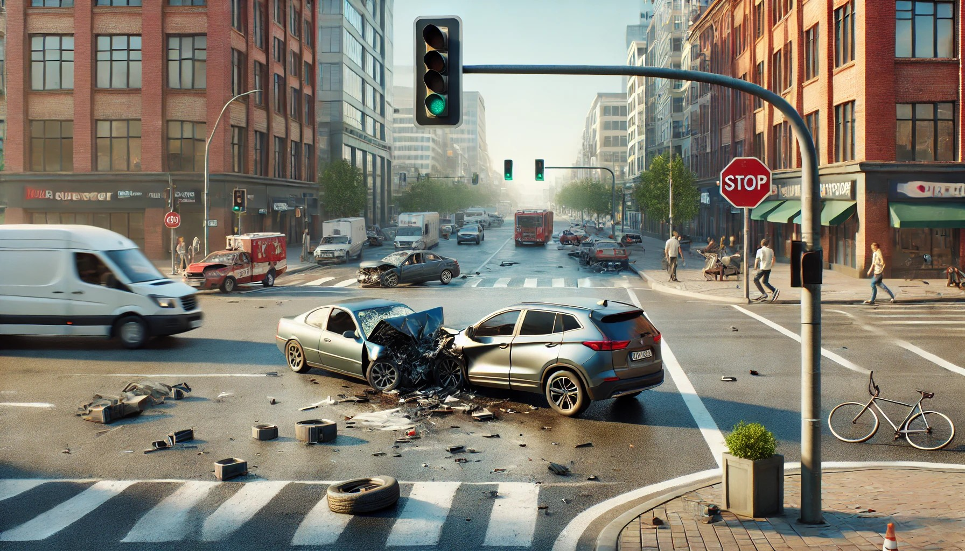
OBJECTIVE & PROBLEM STATEMENT
Existing accident prediction systems use past data and cannot detect dangers in real time, leading to delayed responses and higher accident risks.
Build an SSD-based real-time object detection system to instantly detect obstacles, vehicles, and improving road safety and reducing accidents

Slide 3
Introduction
Fast and Efficient Detection: The Single Shot MultiBox Detector (SSD) is a deep learning model that detects multiple objects in an image in a single pass, making it much faster than traditional object detection methods.
Combined Classification and Localization: SSD identifies objects (classification) and finds their positions (bounding boxes) at the same time, improving both speed and accuracy.
Multi-Scale Detection for Better Accuracy: By using multi-scale feature maps and anchor boxes, SSD can detect small, medium, and large objects effectively, making it ideal for real-time applications like self-driving cars, surveillance, and accident detection.

Slide 4
WORKING PRINCIPLE:
Loading Dataset and Extracting Annotations
Reads images from a folder
Extracts bounding box coordinates (xmin, ymin, xmax, ymax) from each XML file.
Saves the dataset in accident_prone_dataset.mat.
Splitting the Dataset into Training and Testing
Splits the dataset into 60% training and 40% testing using random shuffling.
(training data=180,testing data=120)
Creates image datastores and bounding box datastores for training and testing.
Combines them into a single training/testing dataset.

Slide 5
Loading ResNet-50(backbone in SSD for feature extraction)
Checks if resnet50 exists.
Loads pretrained ResNet-50.
Converts ResNet-50 to layerGraph format.
Creating SSD Detector
Defines anchor boxes (default bounding boxes for SSD).
Specifies feature maps from ResNet-50.
Creates the SSD object detector.
Data Augmentation-Applies random flipping, scaling, and color jittering to images.

Slide 6
Training SSD Model
Defines SGD with momentum (SGDM) as optimizer.
Starts training the SSD model.
Testing the Trained Model
Runs object detection on test images.
Plots detected objects.
Evaluating the Model
Computes precision-recall curve.
Displays mean Average Precision (mAP).

Slide 7
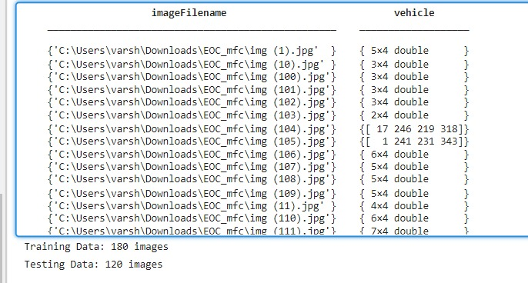
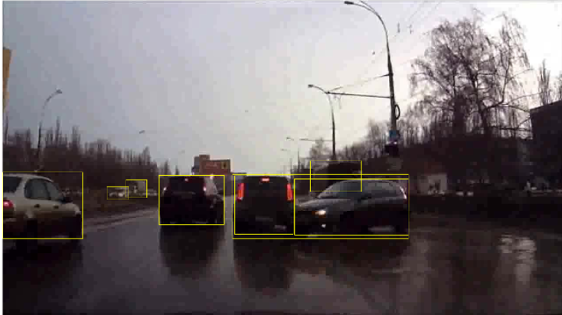
Results(at present):
loads images, extracts bounding boxes from XML files, and stores them in a table for SSD training. If an XML file is missing, it shows a warning and leaves the box empty.
It extracts bounding box coordinates, converts them into (x, y, width, height) format and also splits the dataset into training and testing data
combines them into paired datasets, and displays a sample image with its bounding boxes for verification before SSD training.

Slide 8
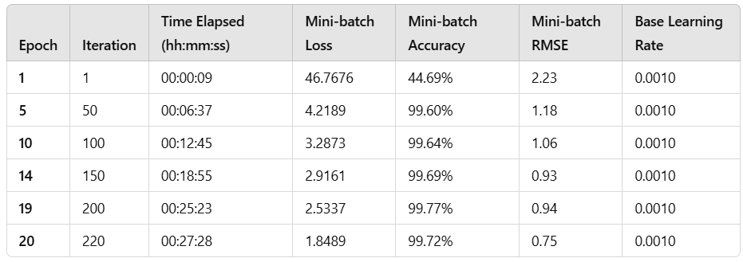
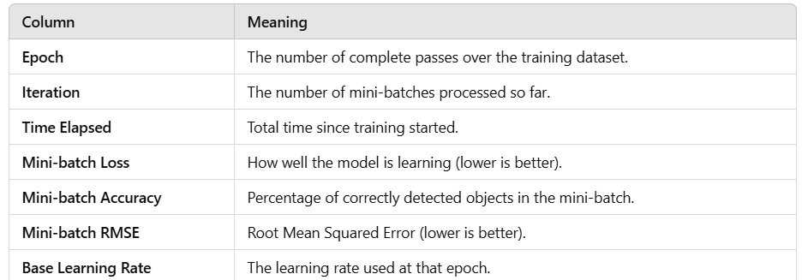
Training Progress Table:
What this means? Each row represents the training state at different epochs (passes over the dataset).
🔹 Understanding Each Column

Slide 9
SIGNIFICANCE OF OUR FINDINGS:
🔹 Observations
Loss Decreases Over Time
Starts high at 46.7676 (Epoch 1) and reduces to 1.8489 (Epoch 20).
Lower loss means the model is learning well.
Accuracy Improves
Starts at 44.69% and increases to 99.72% by Epoch 20.
The model is becoming highly accurate at detecting vehicles.
RMSE Decreases
Starts at 2.23 and reduces to 0.75.
Lower RMSE means better bounding box predictions.
Learning Rate Remains Constant (0.0010)
No learning rate decay happened

Slide 10
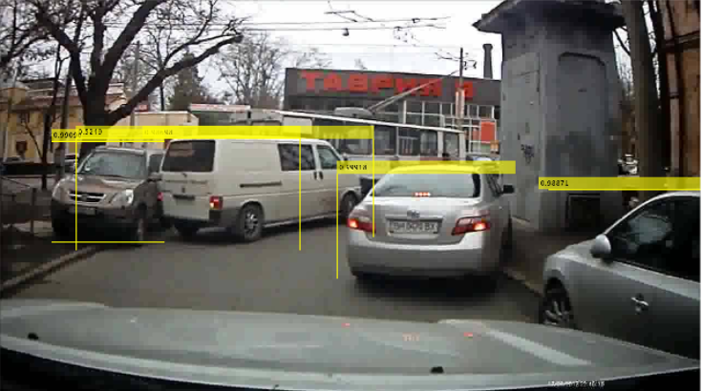
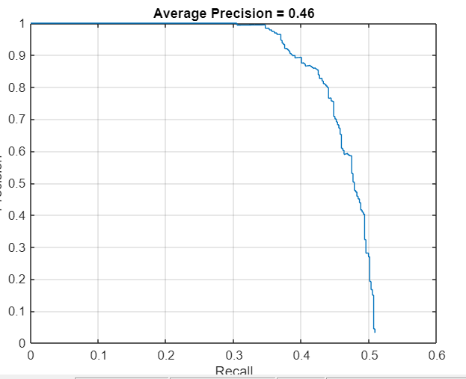
SSD object detection model successfully detected multiple vehicles in the image, drawing yellow bounding boxes with confidence scores. The model identifies objects at different positions but may need fine-tuning for better accuracy and box alignment
Key Observations from the Graph
🔹 Precision starts high but drops as recall increases.
This means the model is accurate at first but struggles when trying to detect more objects.
🔹 Low Average Precision (0.46).
A perfect model would have a value close to 1.0, but here, 0.46 suggests the model is missing many objects or has false positives.
🔹 Sharp drop at higher recall values.
As the model tries to detect more objects, it starts making more mistakes (false positives).

Slide 11
LIMITATIONS(present):
Unable to get high mean average precision due the small size of the dataset loaded.
Unable to run the code efficiently due to the GPU issue.
Struggles with detecting small objects

Slide 12
TIMELINE
JAN 3RD WEEK
SELECTION OF DATA SET
JAN 4TH WEEK
SPLITTING THE DATASET FOR TRAINING AND TESTING
FEB 1ST & 2ND WEEK
MODEL SELECTION FOR TRAINING
FEB 3RD & 4TH WEEK
TRAINING THE MODEL
MARCH 1ST & 2ND WEEK
MODEL EVALUATION
MARCH 3RD WEEK
WRITING PAPER IN LATEX ENVORONMENT

Slide 13
Future Work
Improving the mean average precision.
Adding more evaluating methods.
Writing a research paper on this architecture.

Slide 14
Thankyou

